Slide 1
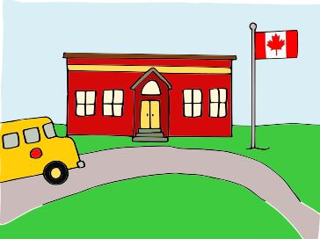
School is Different
A Social Narrative for going back to school during the time of COVID-19
Created by Rose Hogenbirk and Alison England Blanchard

Slide 2
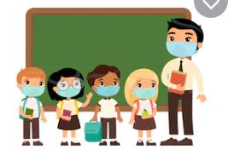
When I go back to school, things will be different. That’s okay. We are safe.

Slide 3
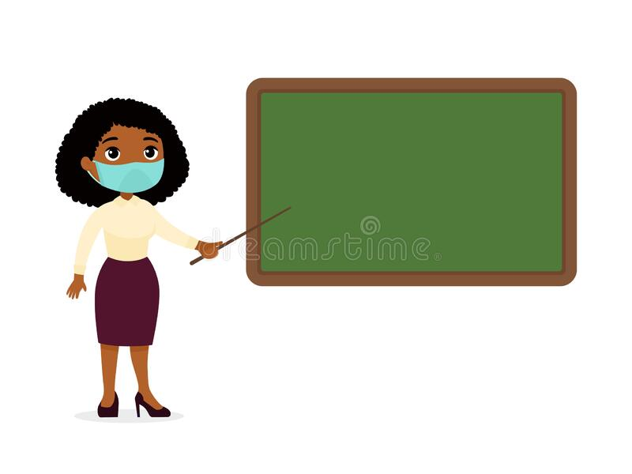
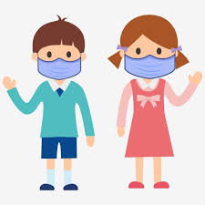
Place photo here
I need to wear a mask when I enter the school. The Educational Assistants and my teachers will be wearing masks too.

Slide 4
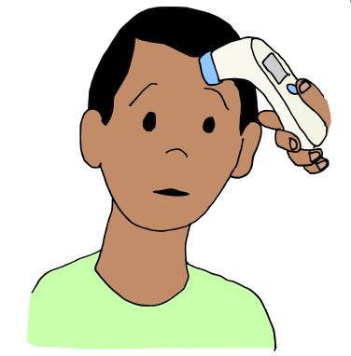
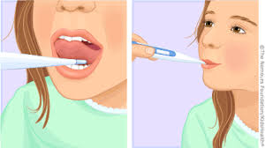
Place Photo Here
____(Name)__________ will take my temperature.​
​

Slide 5
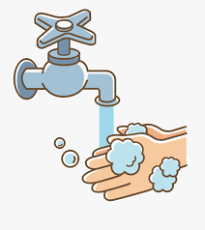
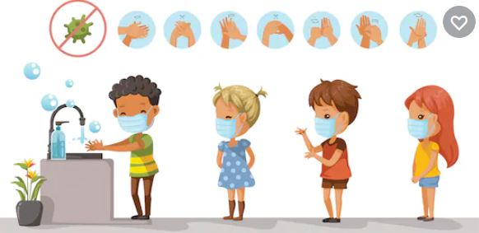
​
I will wash my hands with soap and water! We need to scrub for 20 seconds! Everyone will wash their hands a LOT at school.​​
​​

Slide 6
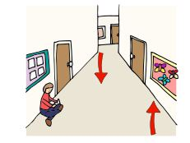
Place photo here
When it’s time to go to the work area/classroom. I will follow the arrows. They show me the safe space to be in the hallway.​​​
​​​

Slide 7
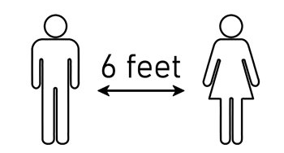
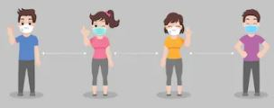
The teachers will help me to practice physical distancing. That means I will need to stay 6 feet away. This will help keep everyone safe.
Place photo here

Slide 8
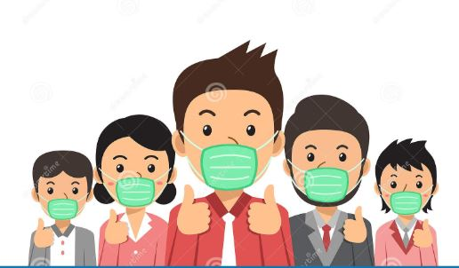
These rules keep us safe. By following these rules, I am helping keep everyone safe.
Everyone is happy when we follow the rules.​​​​​

